Slide 1
Morse-pi project
Morse code in the modern world
BY CHIGOZIE AHAM and Andrew McGuire

Slide 2
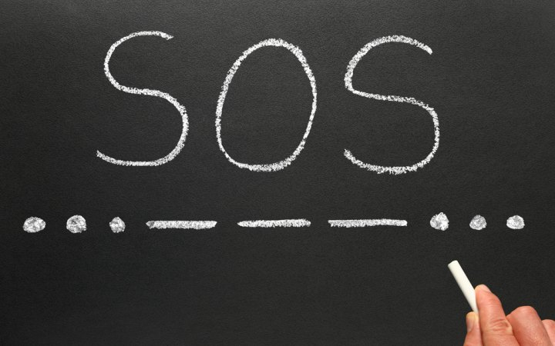
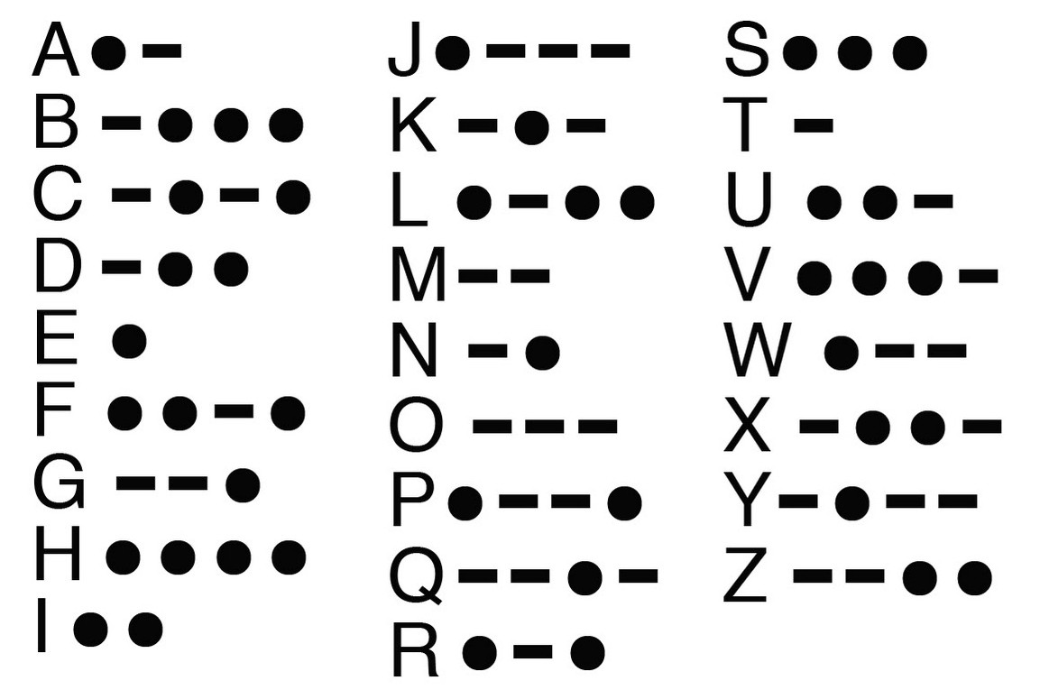
BACKGROUND
Morse-pi project is a project that explores the use of Morse codes in modern day. It consists of a hardware and software component. The hardware includes two raspberry-pi devices that are able to exchange messages in Morse codes and translated thereafter. The messages are saved on a remote server and can be viewed in an Android application, Project code.

Slide 3
COMPONENTS
There are two major hardware components, which are:
Raspberry pi x2
mini LCD screen x2
Single contact key x2
Android mobile device
The software components consist of:
Linux core
MySQL and HeidiSQL for UI database control
Java
Python 3
Raspbian OS
Making of the Morse-pi project

Slide 4
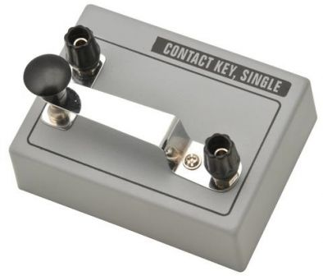
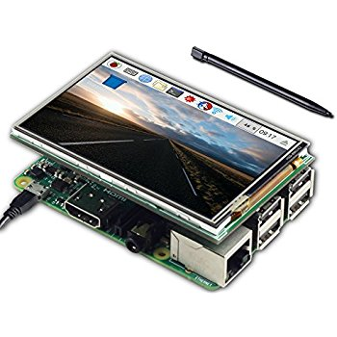
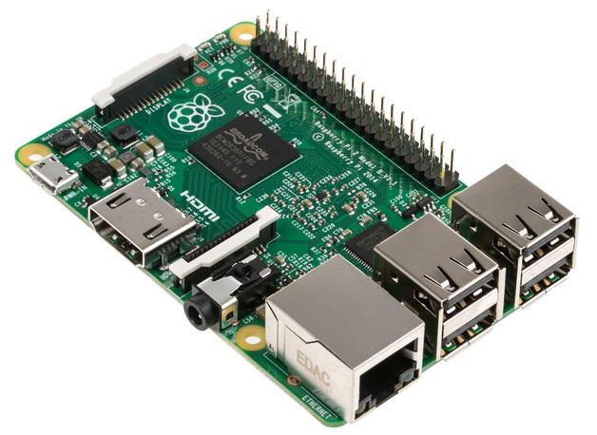
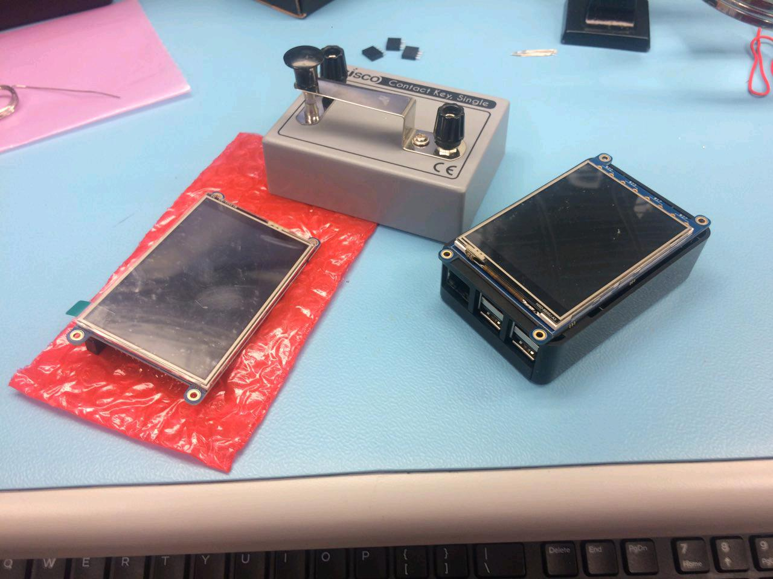



Budget and Hardware parts
$$+$$
$$+$$
$$=$$
Single contact key = $9.77CAD x 2
320x240 LCD = $39.95CAD x 2
Raspberry pi 3 = $99.99CAD x 2
Complete set = $338.34CAD including tax

Slide 5
Resources needed for Successful testing
Stable network connection
Python code for compiling computer instructions
MySQL for database needs
Java for Android programming
Remote server for hosting database

Slide 6
Guide
First of all, set up the raspberry pi hardware connection with the single contact key. Making sure the ground and the source power are properly connected.
Secondly, a connection has to be established between the two raspberry pi devices so a stable network connection is required. One of the two devices run as the client while the other runs as the server. Both devices would connect using the server’s IP address, so before executing any source codes, the IP address has to be sorted out. Once the code is executed successfully, a message that reads “Ready” will be displayed on both screen.
Next, User can start entering the Morse codes using the single contact key. The Morse codes are sent to the database immediately before being transmitted to the other user.
The receiving end gets the Morse codes translated into English. The receiving user is also able to send back to the sender by entering Morse codes using the single contact key.

Slide 7
Courses that helped us be successful in our system project
CENG 320 – Network Program (socket programming)
CENG 319 – Software Project (Android Studios, Java)
CENG 251 – Unix Internals (familiarity with Linux based environment)
CENG 256 – Internet Programming(PHP)
CENG 254 – Database with Java (MySQL)
CENG 252 – Embedded Systems (Understanding System I/O)

Slide 8
What we’ve learned for this project
Python code for connecting to DB
JSON objects for fetching from DB in Java and PHP
Hardware and Software Solution for Debouncing
XML views not fully discussed and learned in previous course

Slide 9
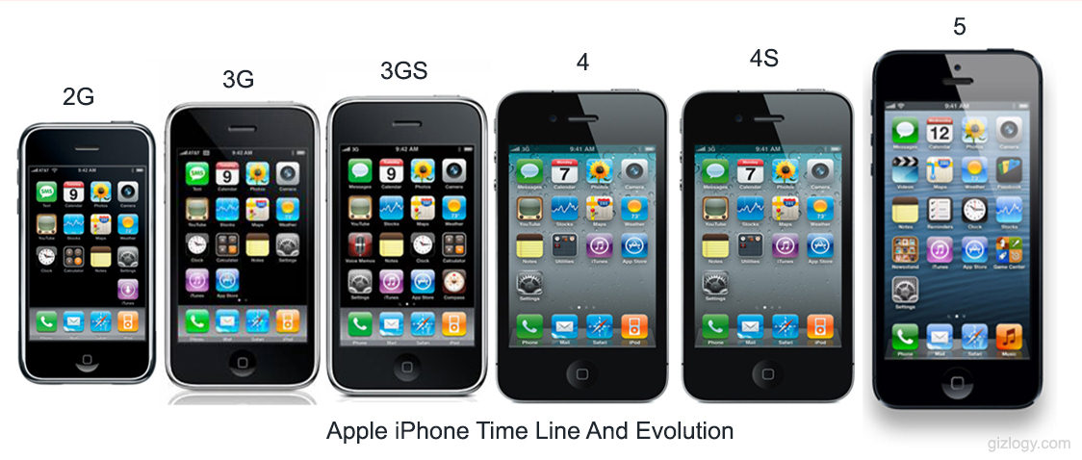
Potential Future of morse pi project
Radio channels on the Android device for different users to connect and exchange messages
Android device as a third person in the chain of communication. This would enable the mobile device as not just a receiver but also a sender.
Friendly UI on raspberry pi devices
Database table for users

Slide 10
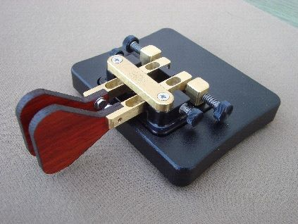
What we would do differently
Pi Login feature Design a PCB that would fit the LCD display and a Morse Paddle

